Slide 1
Digital Portfolio
STUDENT NAME: Deepika .V
REGISTER NO AND NMID: asunm2401111033003
DEPARTMENT: BCA (computer application)
COLLEGE: LN GOVERNMENT COLLEGE/ MADRAS UNIVERSITY

Slide 2
PROJECT TITLE
"Personal Digital Portfolio Website Using HTML,
CSS and JAVASCRIPT"

Slide 3


AGENDA
Problem Statement
Project Overview
End Users
Tools and Technologies
Portfolio design and Layout
Features and Functionality
Results and Screenshots
Conclusion
Github Link
3/21/2024 Annual Review

Slide 4

PROBLEM STATEMENT
Traditional resumes don't show practical skills clearly
Students face differenty in presenting academic projecs
Professionally
Recruiters want to see real work and live example
No central platform for showcasing skills,
Projects,and achievements
A digital portfolio sloves this by combining
resume,projects,and creativity

Slide 5

PROJECT OVERVIEW
Developed a responsive personal portfolio website
Includes sections :Home,About,Skill,Project,and Contact
Highlighs career goals,technical abilities,and achievement
Projects displayed with cards,hover effects,and
animation
Contact section with from and social links
Works on both desktop and mobile devices

Slide 6

WHO ARE THE END USERS?
Students:Showcase academic work&resumes
Job seekers:Share portfolio link with recruiters
Freelancer:Attract clients with projects and demos
Professionals:Build personal brand and credibility
Accessible anytime,anywhere,making users stand out

Slide 7

TOOLS AND TECHNIQUES
HTML :Tools and Technologies
CSS :Styling,layout,responsiveness
JAVASCRIPT :Interactivity,animations,from validation
Developed in VS Code/Code pen
Hosted on github pages/ Netlify for global access

Slide 8
POTFOLIO DESIGN AND LAYOUT
Clean,modern,and user friendly design
Smooth navigation between sections
Responsive for mobiles,tablets and desktop
Project cards with images,descriptions,and hover effects
Contact from with clickable email/social links
8

Slide 9
FEATURES AND FUNCTIONALITY
1.Easy navigation with smooth scrolling
2.interactive design with animation
3.professional first impression for recruiters
4.Works across devices (desktop,Mobile)
5.Direct communication via contact from
6.Portfolio link can be shared on LinkedIn,resumes,and emails

Slide 10
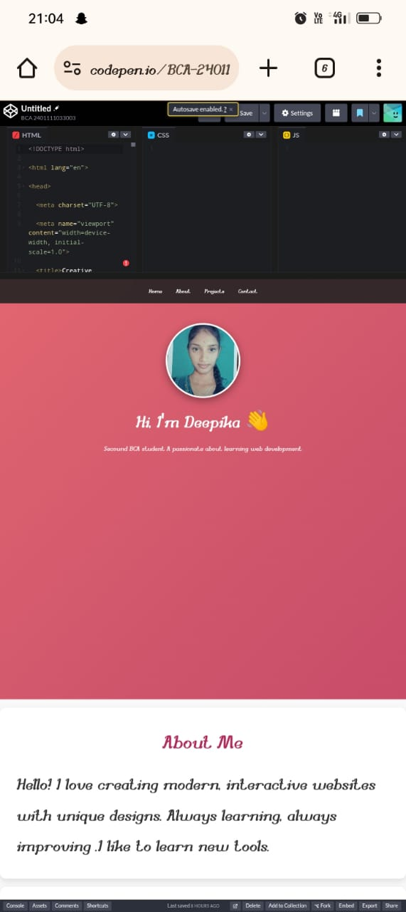
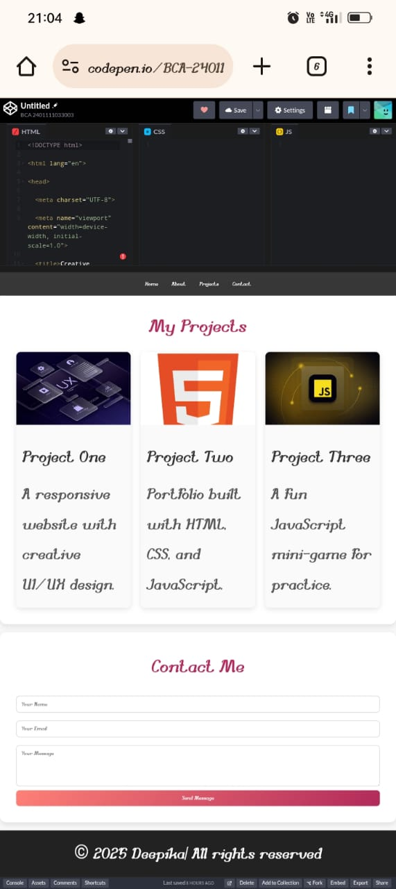

RESULTS AND SCREENSHOTS
3/21/2024 Annual Review
10

Slide 11
CONCLUSION
A digital portfolio is a modern alternative to resumes
Shows technical knowledge in HTML ,CSS,JavaScript
Demonstrate ability to build professional,responsive websites
Useful for students,job seekers,and freelancers
Boost visibility credibility,and career opportunities
A strong digital identity for the modern era
11

Slide 12
GitHub link
https://deepika200607.github.io/KJ-Deepi-/

